Slide 1
#EconomicOpportunitiesForAll
Registration, Self-Assessment & Course Enrollment
09th October 2023

Slide 2
What is Futurenation
Futurenation program will Assess the candidate for finding out employability potential based on the employer’s assessment requirement, Provide guided customized Skills Training according to employment prerequisites, and finally, Connect with the private sector employers with the right job placement.

Slide 3
This Manual Shows-
Technology Platform Registration
Self-Assessment Enabling
Course Enrollment

Slide 4
Futurenation Technology Platform
Futurenation Technology Platform is an AI-enabled data-driven platform:
Will support finding out the student’s Employability Potential through an assessment test that is aligned with private sector employers’ assessment requirement
Will offer the student a guided upskilling journey with demand-driven customized skill courses according to the job market requirement from the private sector employers.
Will connect the potential candidate with private-sector employers for job placement with their real-time job offers

Slide 5
Part 1: Futurenation Platform Registration Journey

Slide 6
https://platform.futurenation.gov.bd
First, type https://platform.futurenation.gov.bd in your browser
Search

Slide 7
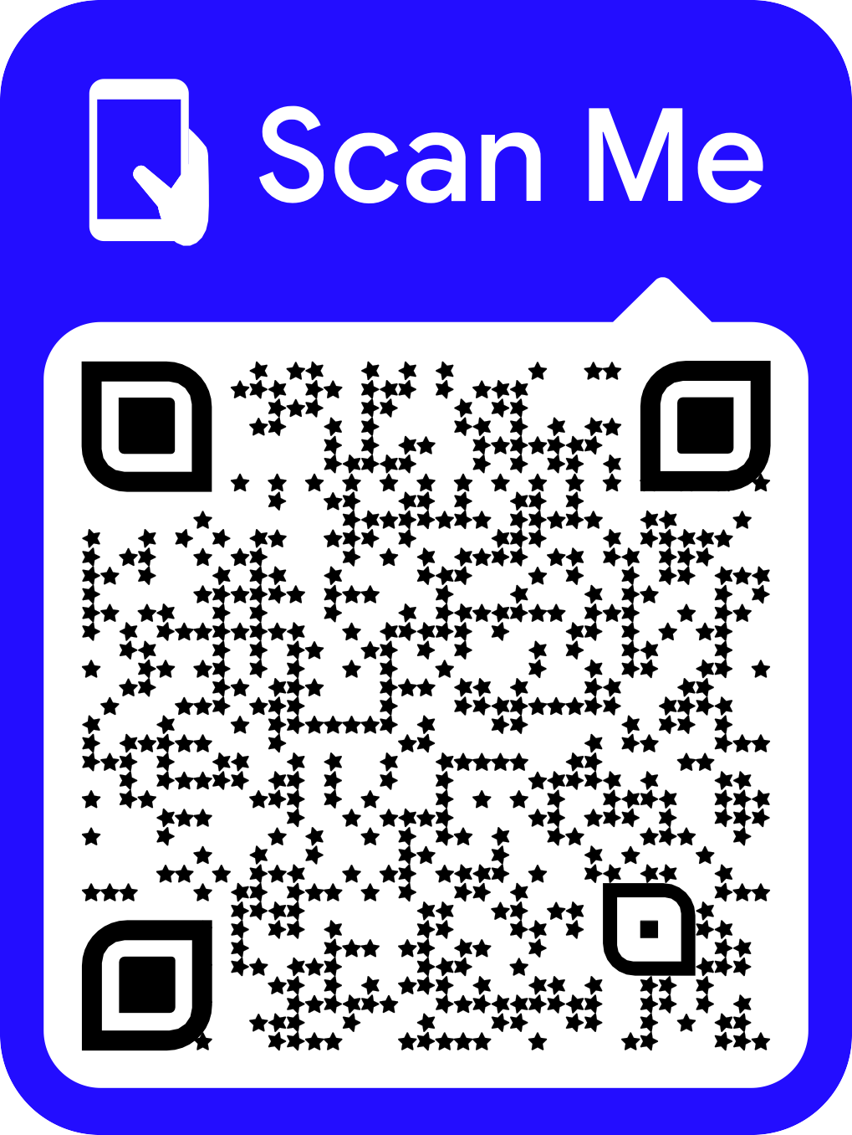
Or scan the QR code to redirect to the platform

Slide 8
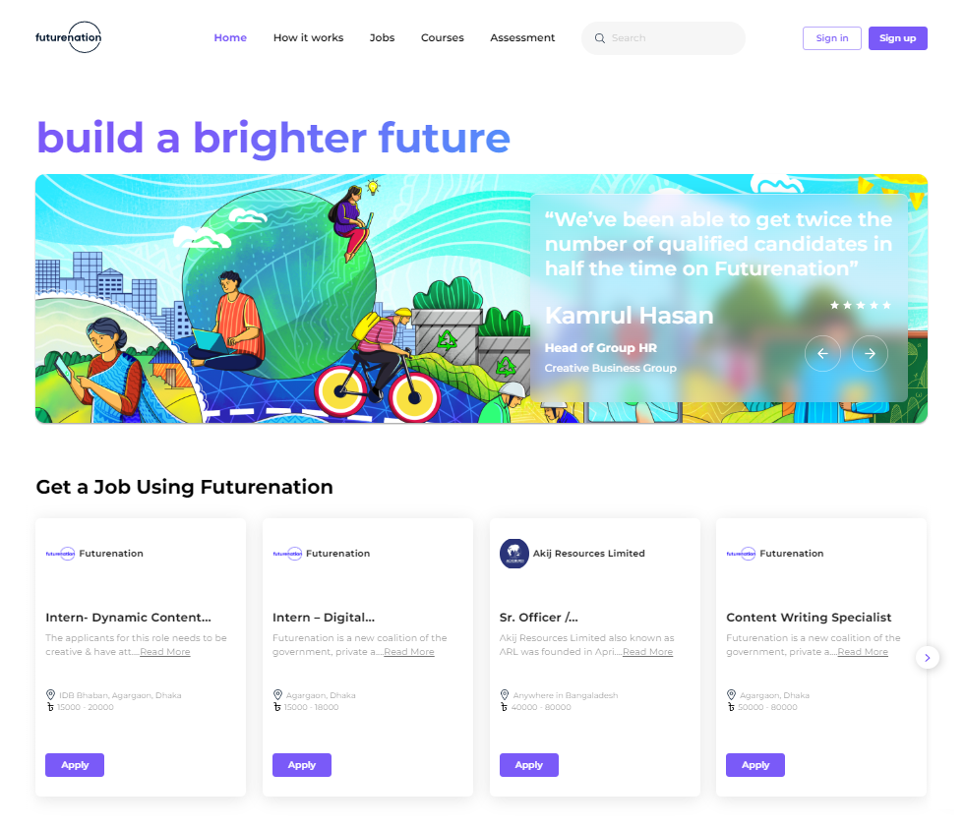
Go to the Sign-up section by clicking here

Slide 9
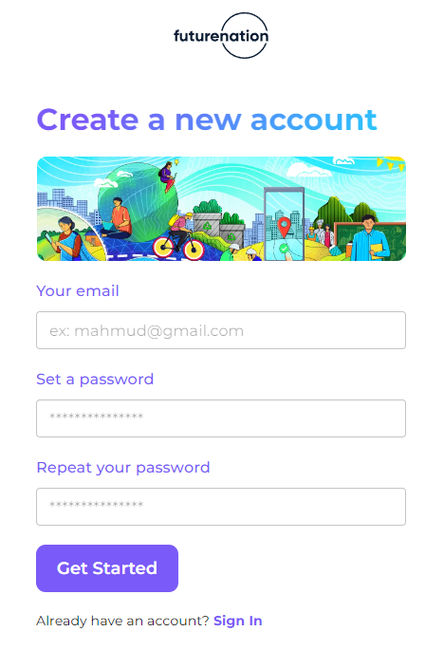
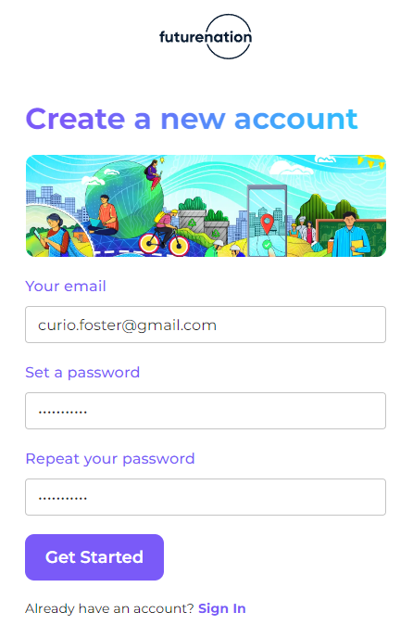
You will need to fill out the following information:
Provide your email address and set a password

Slide 10
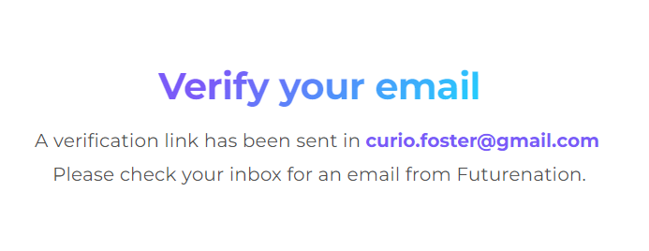
Please open the inbox of your provided email address
Open the mail from Futurenation and click the verification link

Slide 11
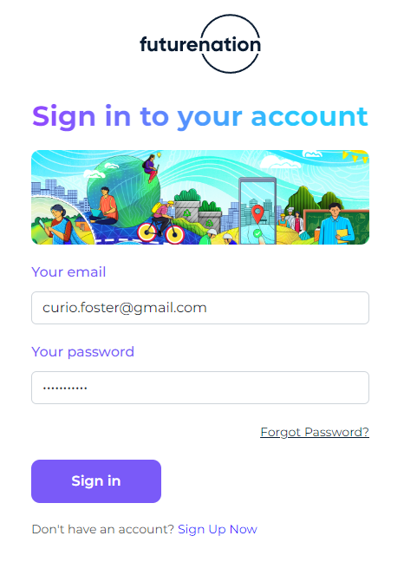
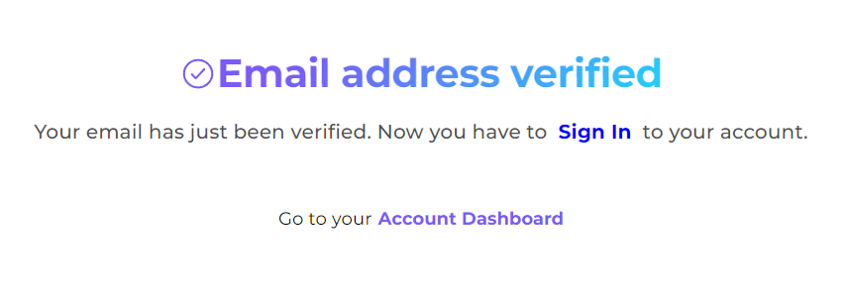
Once email address is verified, Sign-in to your account
by providing your email address and password

Slide 12
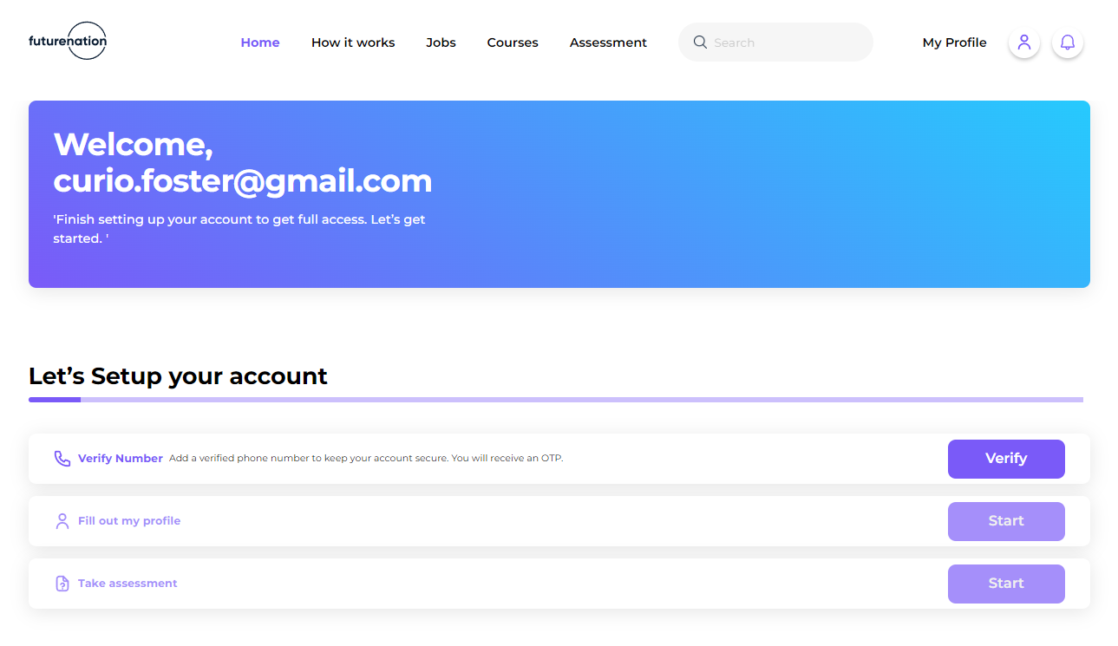
After signing in to your account, you will view your account dashboard
This will guide you through the onboarding journey
Starting with your phone number verification

Slide 13
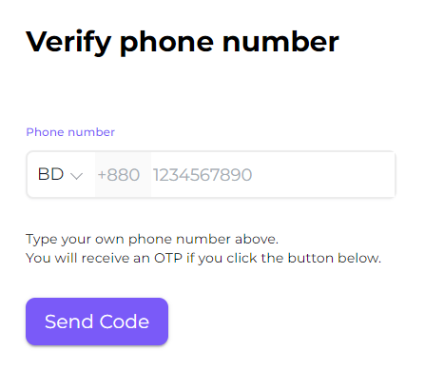
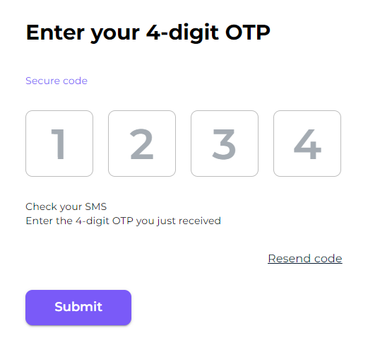
Enter your phone number and click “Send Code”
A four-digit OTP will be sent to your phone number
Once received, enter the code and click “Submit"

Slide 14
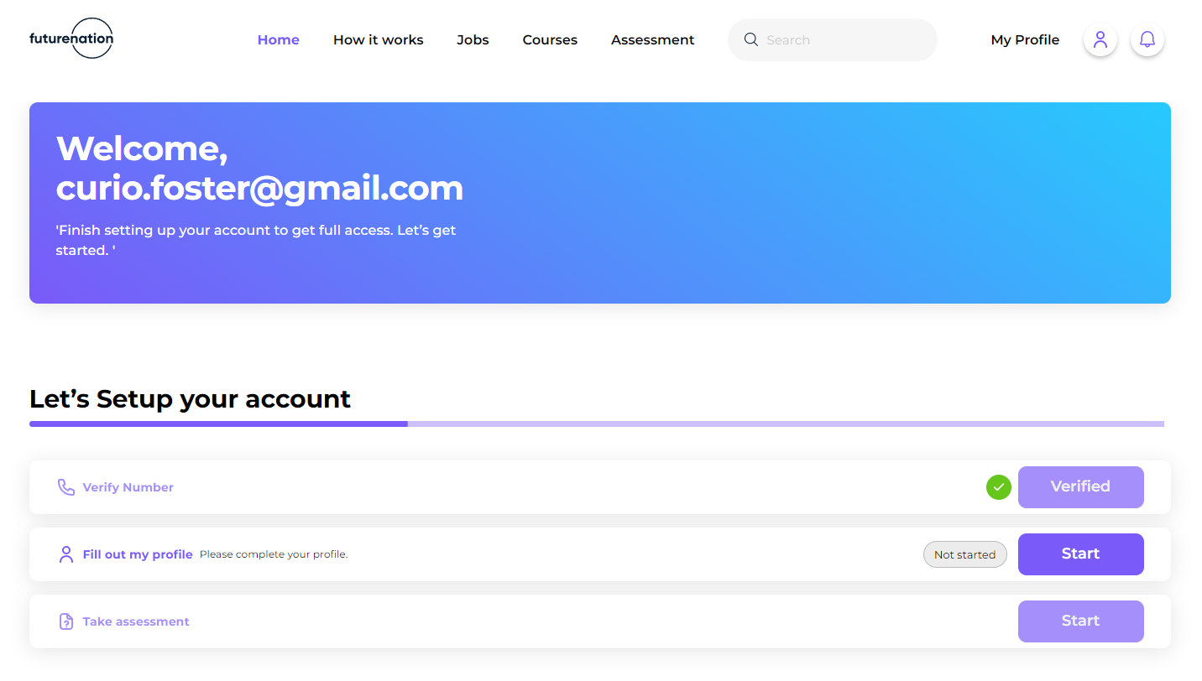
After your phone number verification
fill out your profile information by clicking “Start”

Slide 15
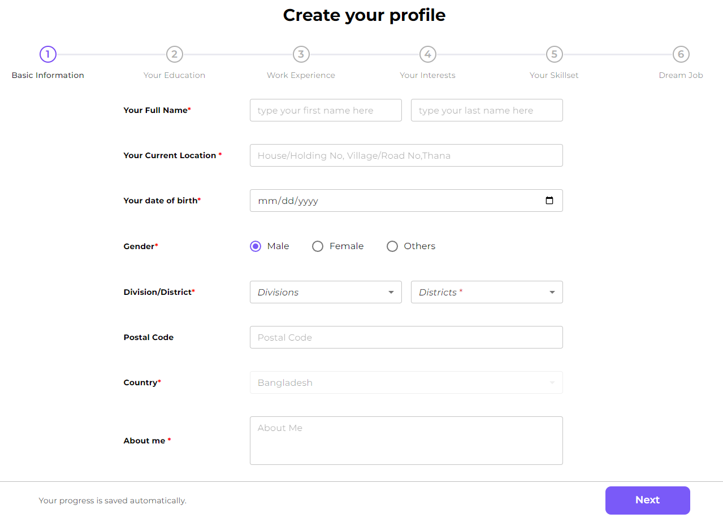
Step 1 provide your name, location, DoB, district, postal code
And provide a short introduction in “About me” section

Slide 16
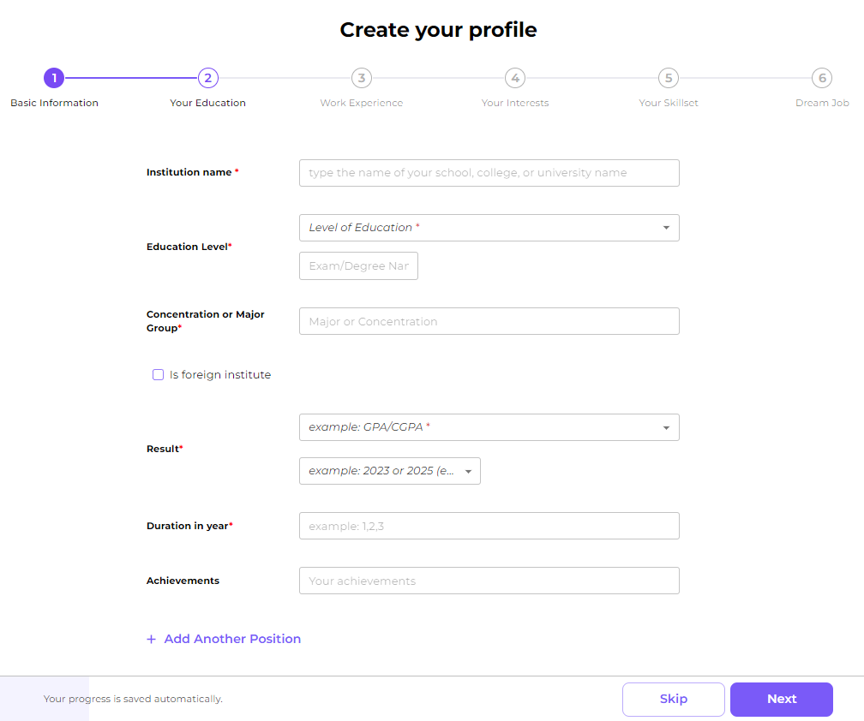
Step 2 provide your all academic background information
Click “Add Another Degree” to add different levels of education

Slide 17
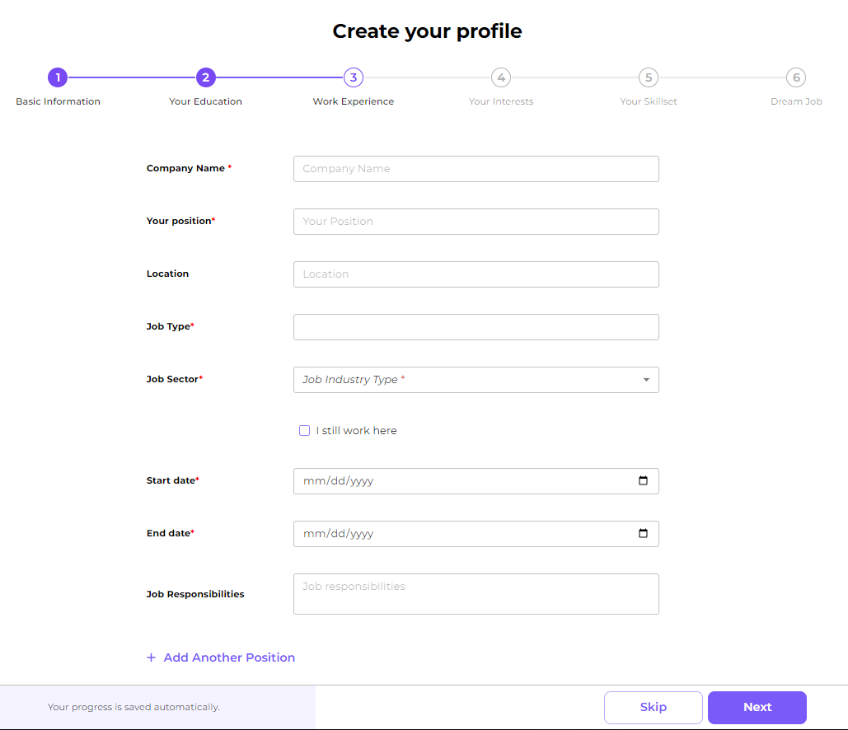
Step 3 provide professional experience information (if any)
Click “Add Another Position” to add different work experiences

Slide 18
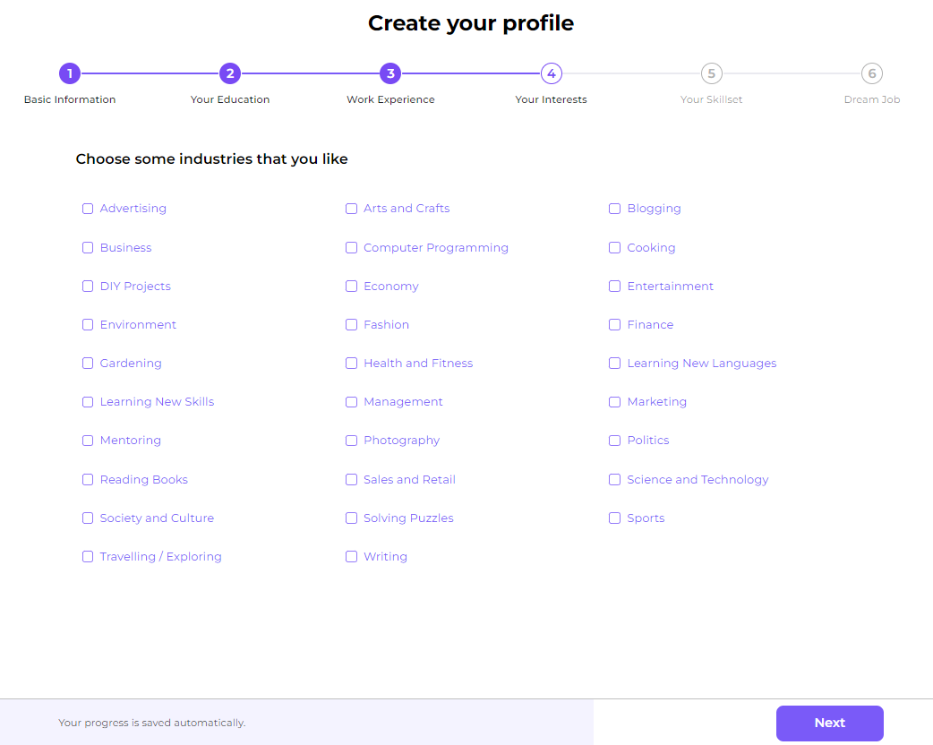
Step 4 select the industries where you want to build your career

Slide 19
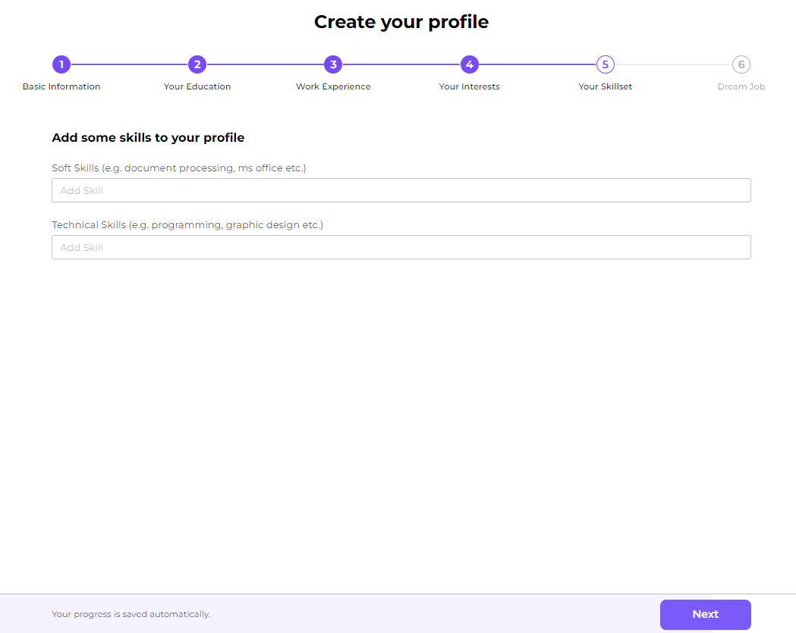
Step 5 select the skills that you already posses

Slide 20
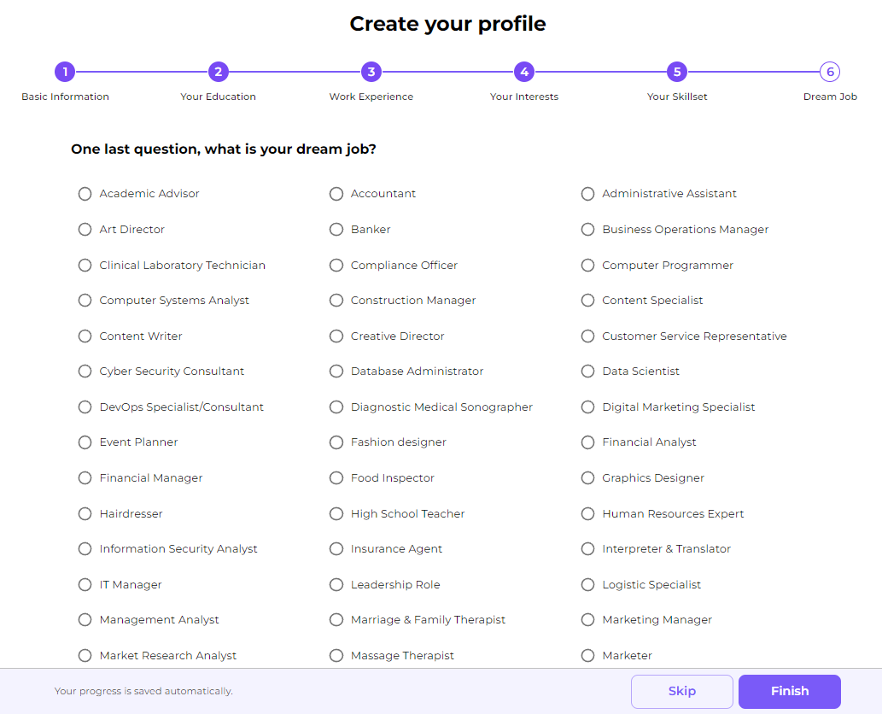
Step 6 select the role that you are aspiring

Slide 21
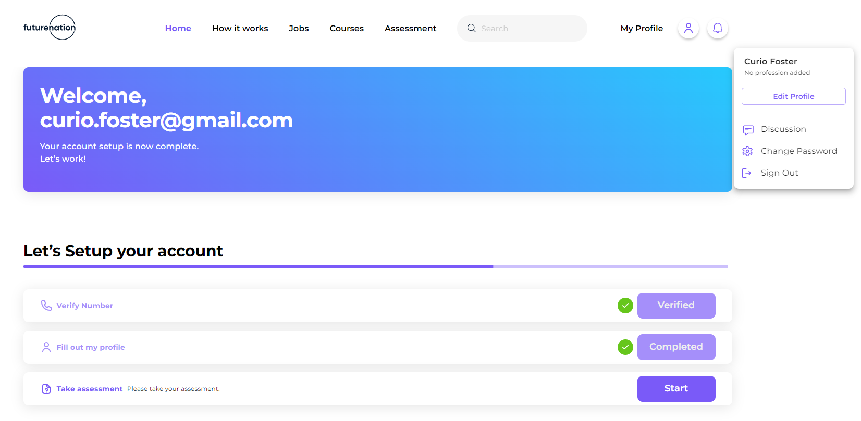
Now that your profile has been completed
you can click “My Profile” to view your profile

Slide 22
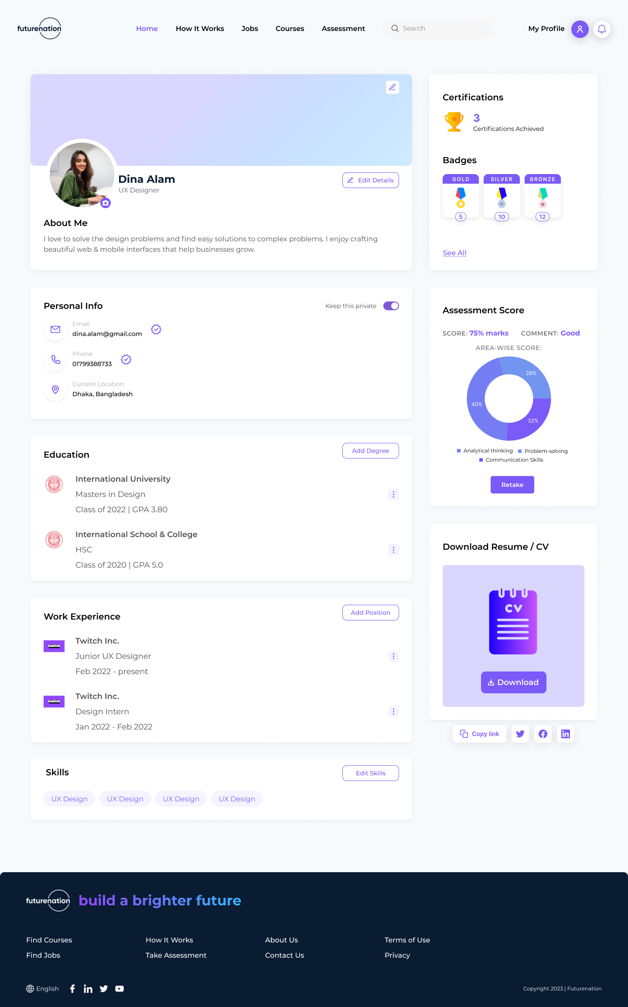
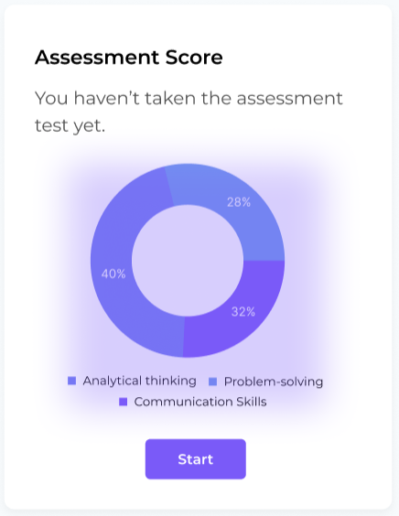
Once your profile has been completed, a professionally graded CV will be available for
download.

Slide 23
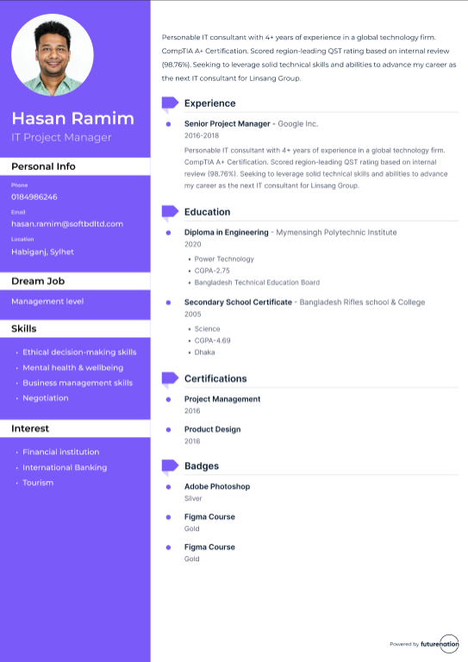
Sample CV Export

Slide 24
Part 2
Self-Assessment Enabling

Slide 25
What is Self-Assessment
Self-assessment is an individual review performed –
To identify skills that can be improved to achieve certain determined goals.
To analyze himself/herself to improve perspective about his/her capabilities and potential in the workplace.

Slide 26
Skills and their implications at the workplace
Analytical Ability
Problem Solving
Communication
The ability to examine information or a situation in detail in order to identify key or important elements, their strengths and weaknesses and use these to compile a persuasive argument, make recommendations or solve a problem.
The ability to define or identify the problem, generate alternatives or potential solutions, evaluate and choose between these and implement the chosen solution.
The ability to give and receive information - both verbally and in writing - that is clear, well structured and targeted to the intended audience.
Data and information
Creative thinking
Rational solutions
Logic, Creativity
Resilience, Imagination
Lateral thinking, Determination
Convey accurate information
Effective communication
Improve human relationship
An analytical person in the workplace focuses on making sense of the facts and figures and using logical thinking practices to identify a fix.
Problem solvers can observe, judge, and act quickly when difficulties arise when they definitely do.
Ensures employees have the information they need to perform well, builds a positive work environment, and eliminates inefficiencies.

Slide 27
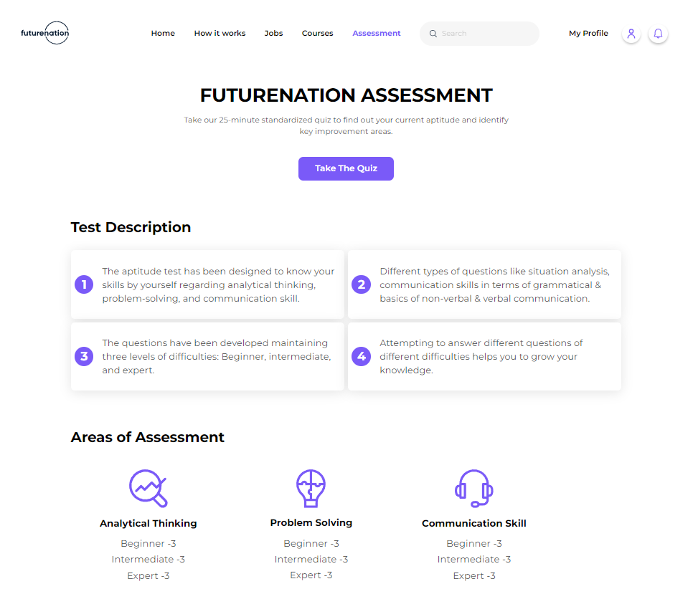
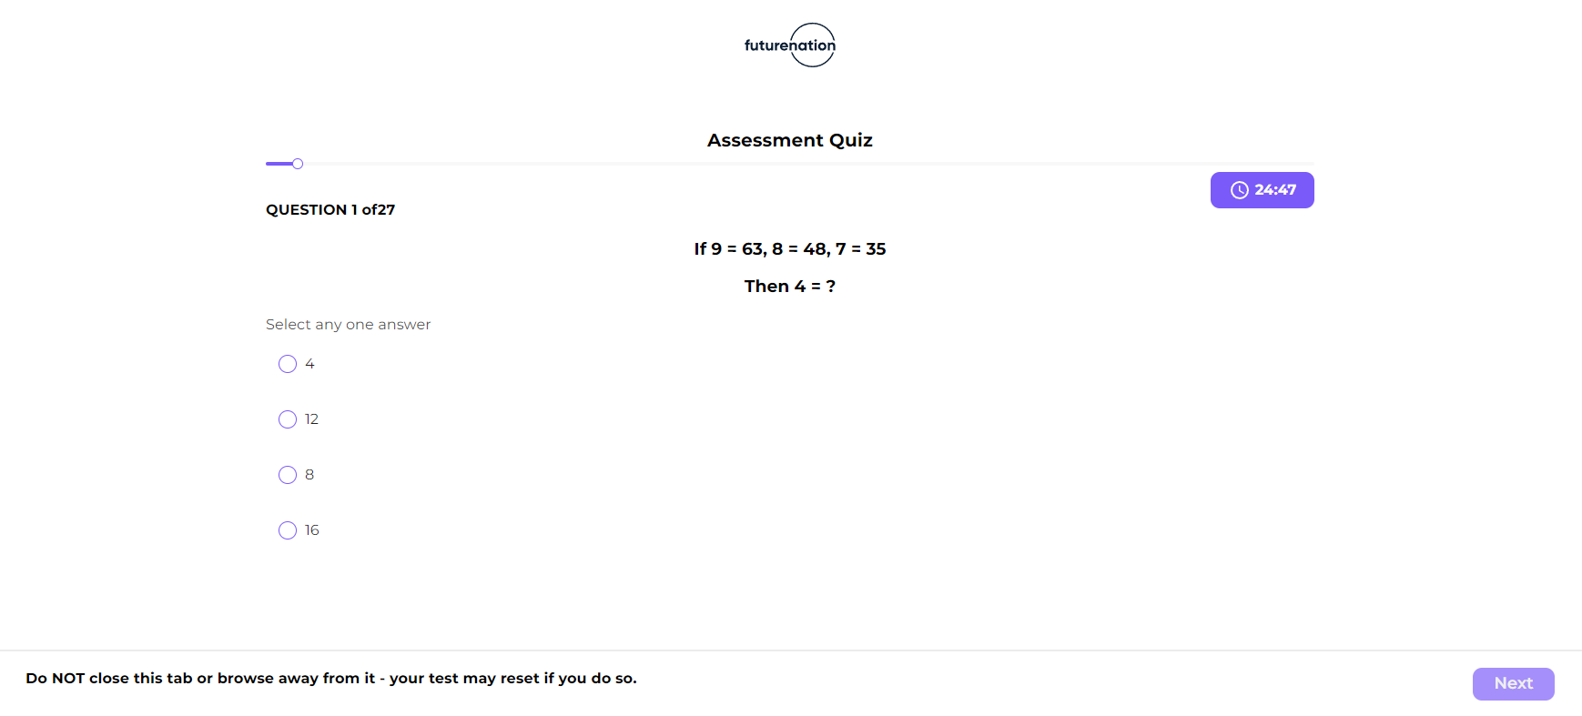
You'll find a button called “Take The Quiz”.
Click on it and you'll be able to take the Aptitude Test which evaluates your skills.

Slide 28
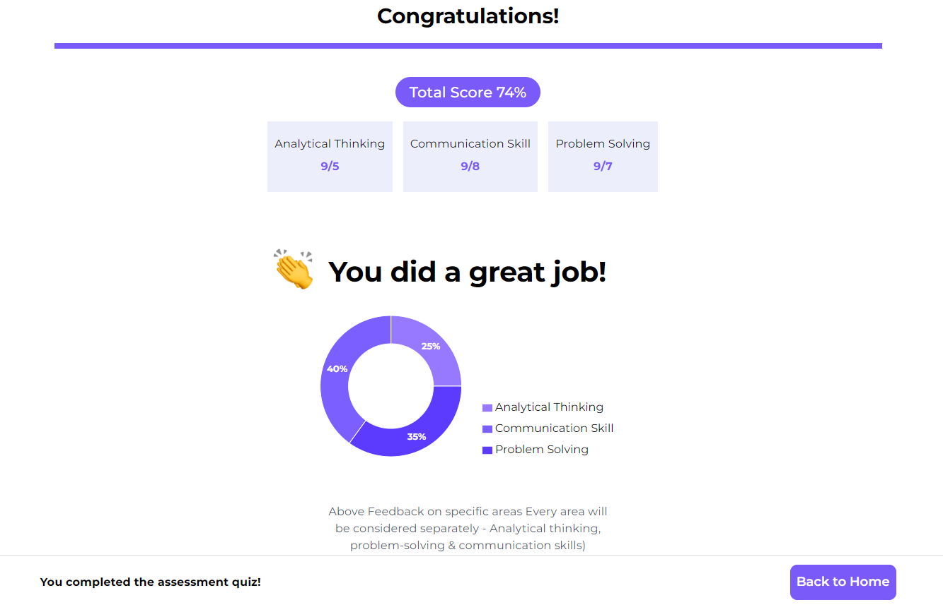
Assessment Results
Score Ranges | Feedbacks
Above 80% | Very Good
60% - 80% | Good
40% - 60% | Need Improvement
Below 40% | Re-assessment

Slide 29
Part 3
Course Enrollment Journey

Slide 30
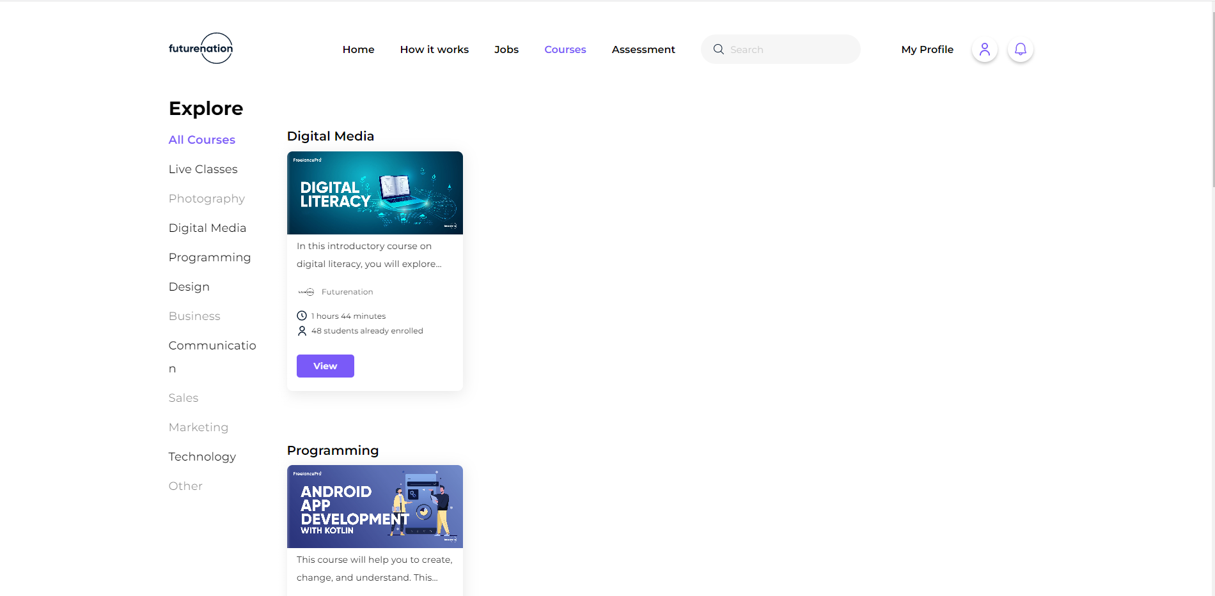
Click ‘Courses’ to view the courses

Slide 31
Click ‘View’ to view the course details

Slide 32
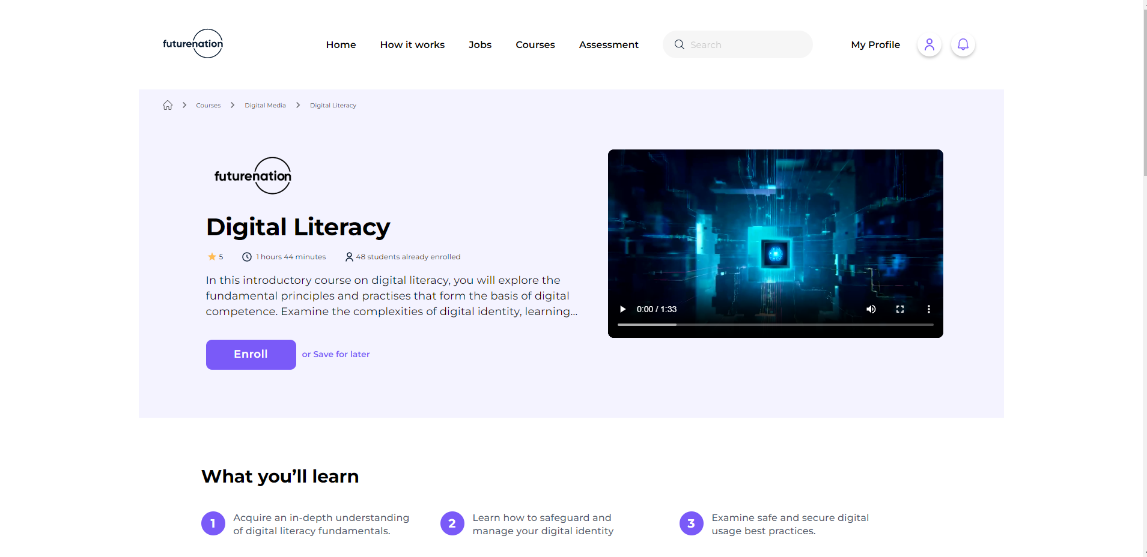
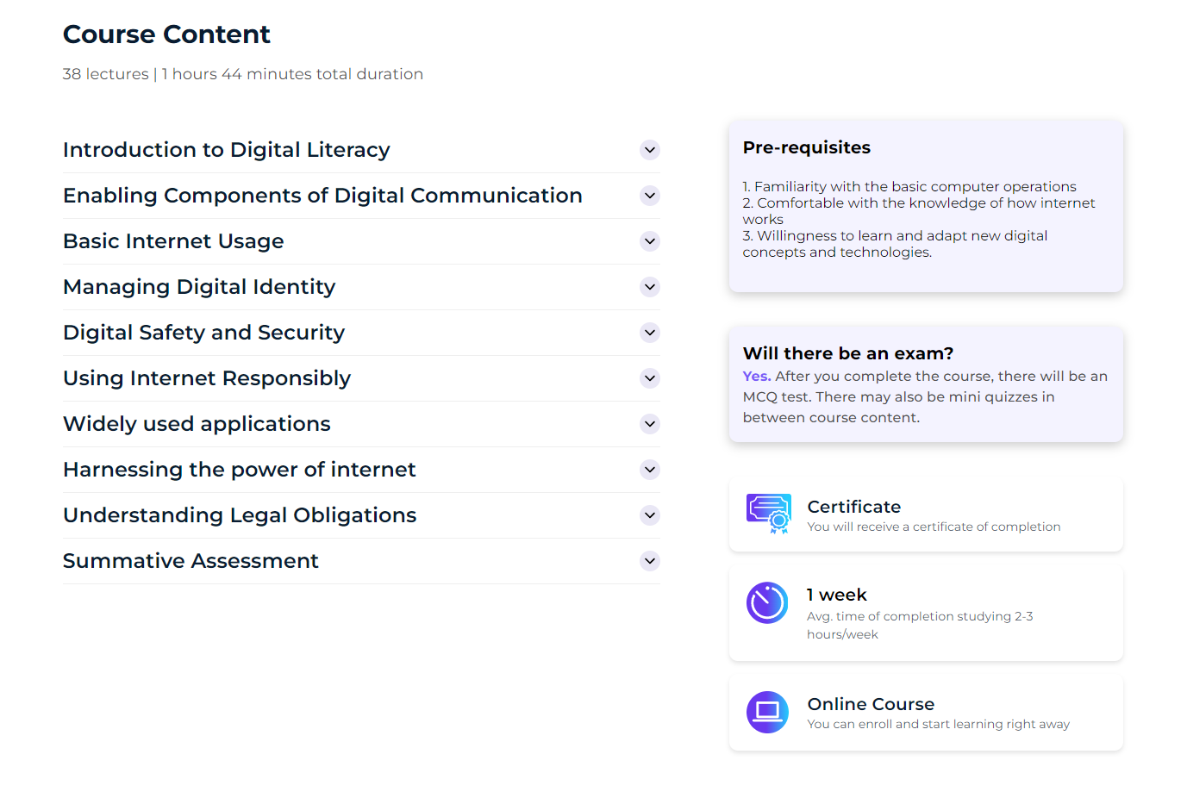
Course Outline View

Slide 33
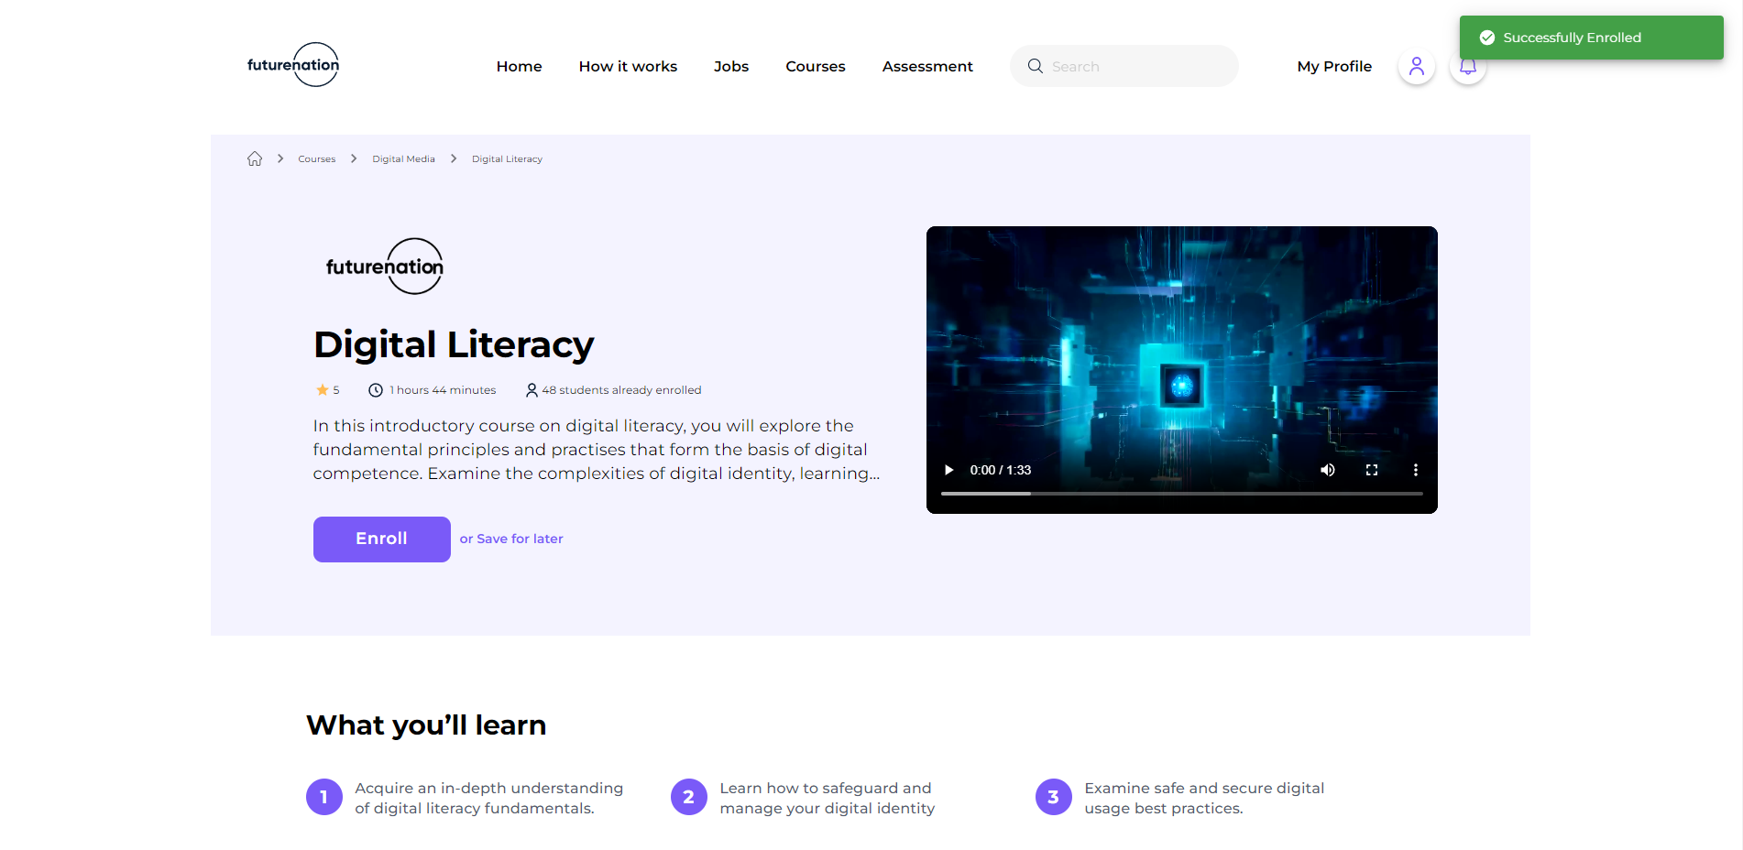
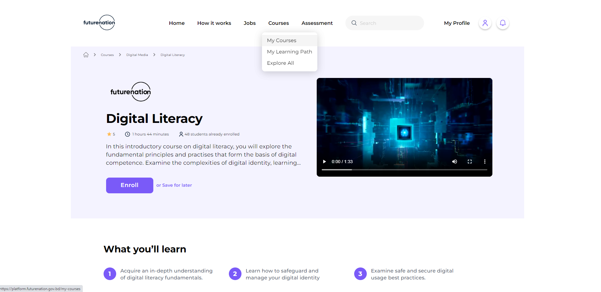
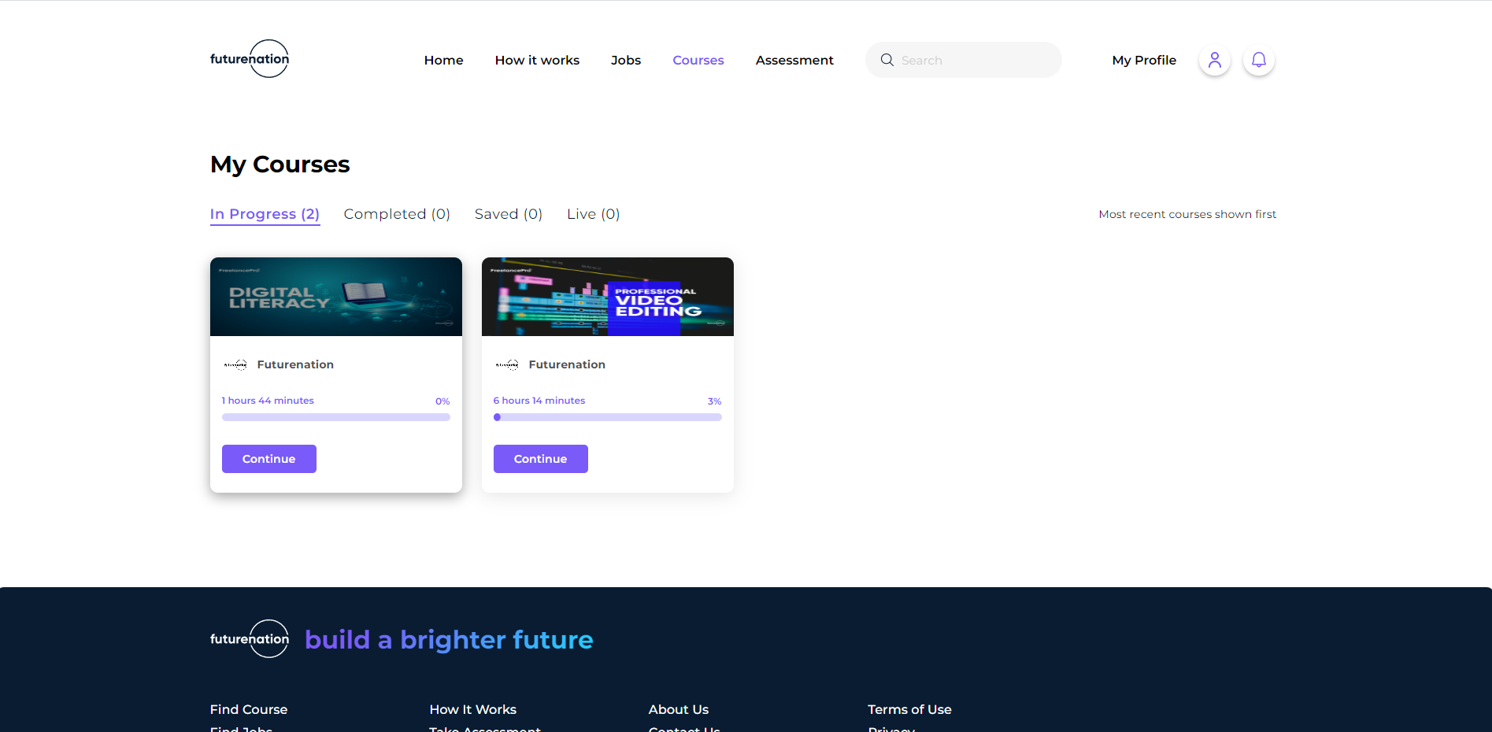
Get Enrolled, Go to My Course and Start the Course

Slide 34
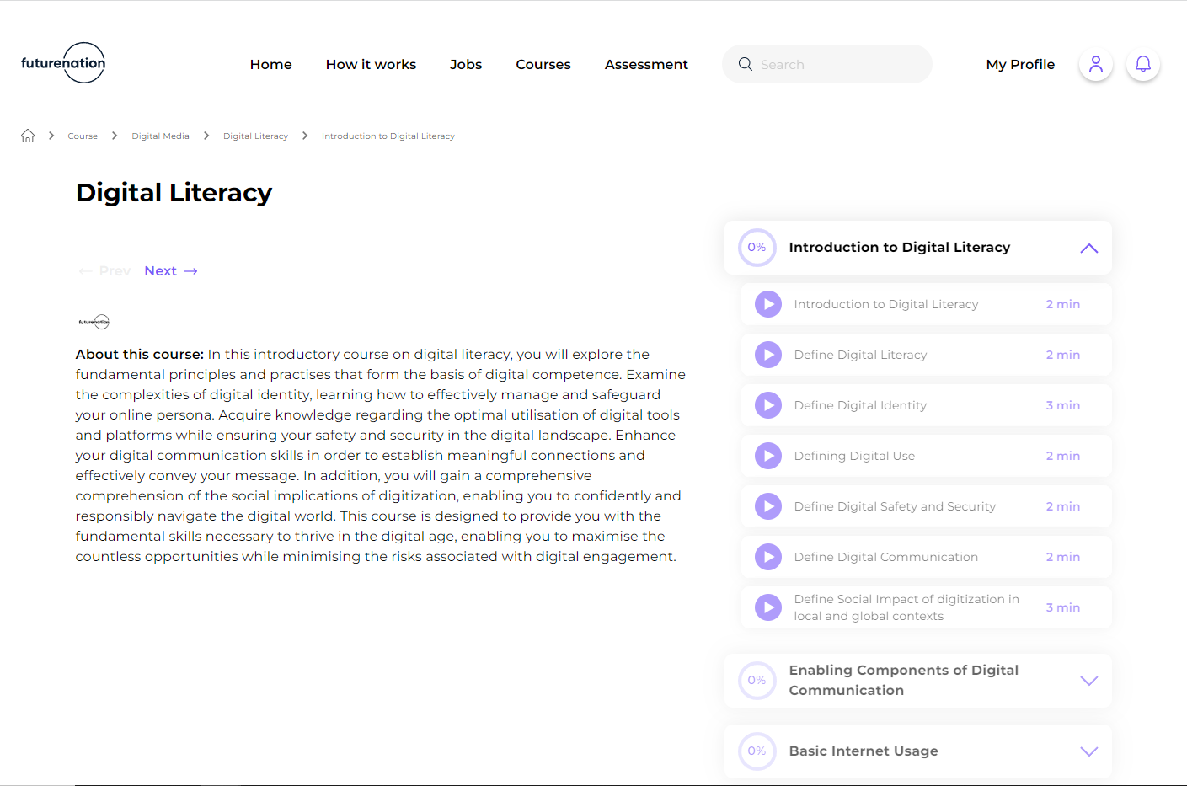
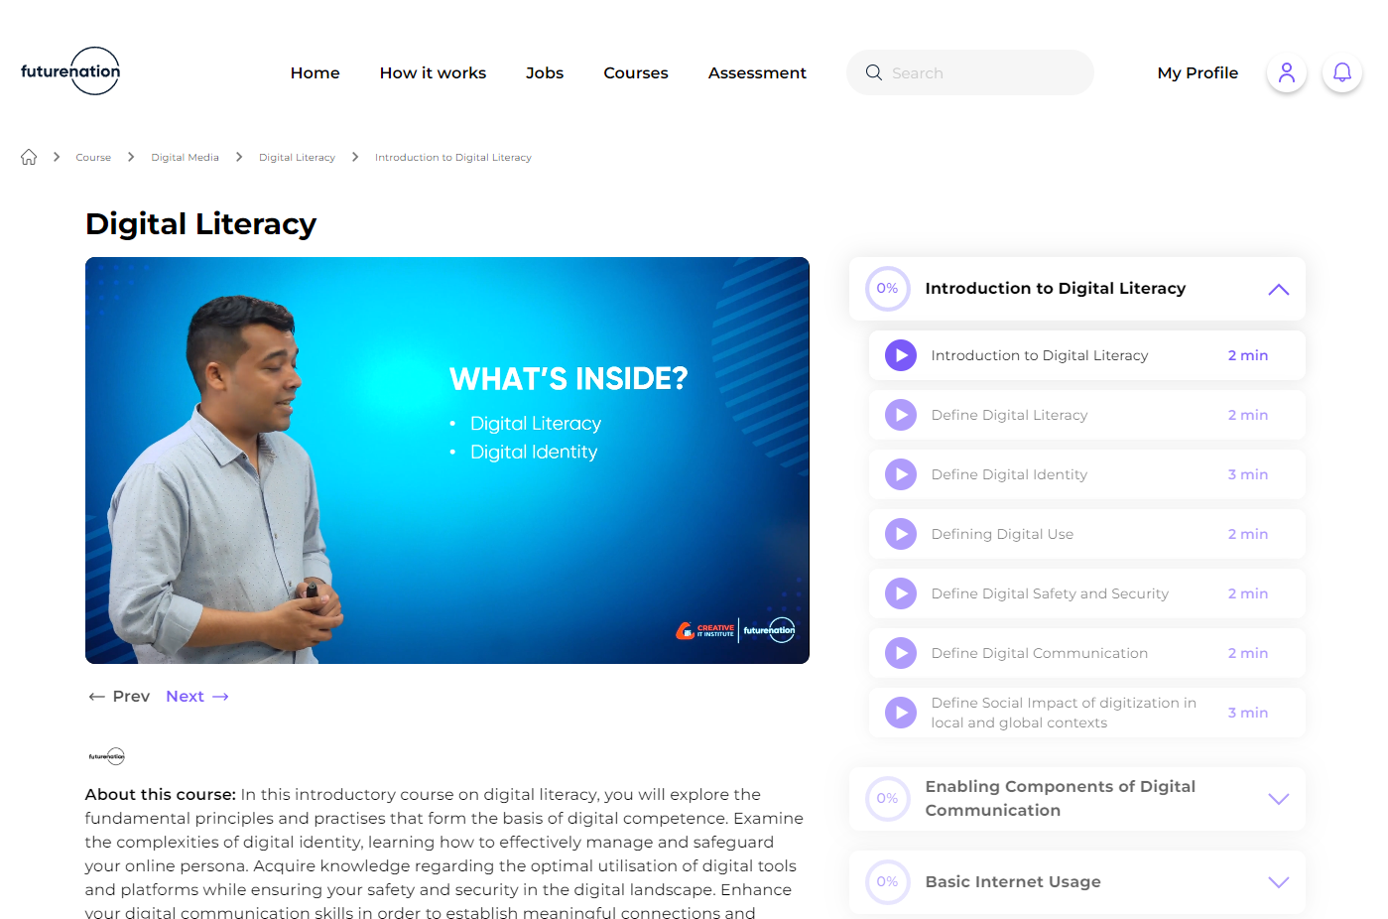
The course journey goes like this

Slide 35
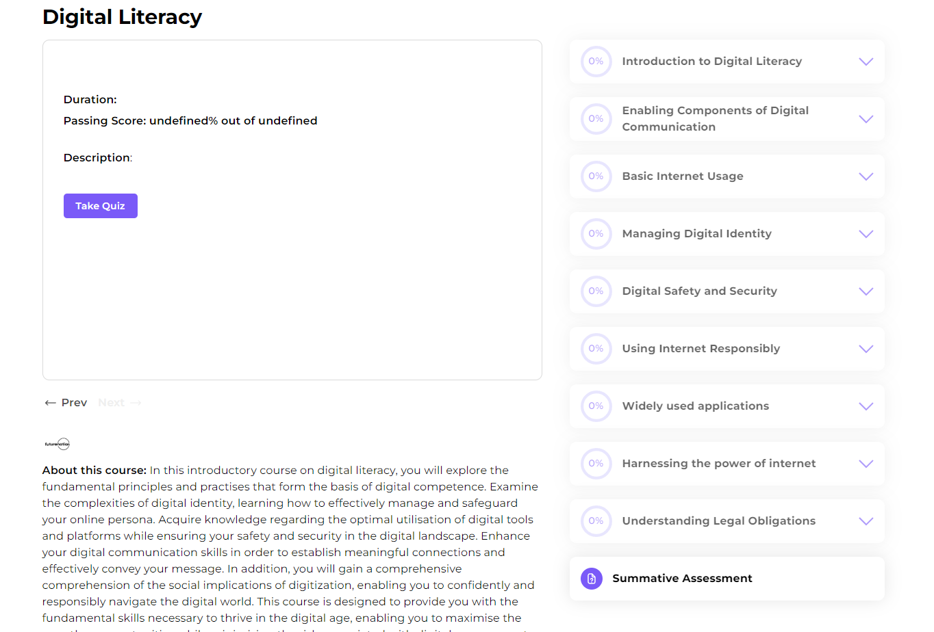
In-Course Assessments in each module and a Summative Assessment at the end of course. Upon successful completion of each course, you get a certificate.

Slide 36
Further Queries and Contact Details
For further queries, please email us at info@futurenation.gov.bd or visit us at https://futurenation.gov.bd/.
To find the technology platform from your mobile device, scan the QR below.
Or go to: https://platform.futurenation.gov.bd

Slide 37
Thank You

